Slide 1
Higher Rates for Longer
Building Systems Housing Summit
October 17, 2023
Danushka Nanayakkara,
NAHB AVP, Forecasting and Analysis

Slide 2
GDP – Moderate Growth in 2023
Soft landing?
Increased 35.3% during the third quarter of 2020
Dropped 29.9% during the second quarter of 2020
Source: U.S. Bureau of Economic Analysis (BEA) and NAHB forecast.

Slide 3
Unemployment Bottoming Out and Will Rise
Job growth will slow as we head to 2024

Slide 4
Consumer Inflation – Headline Rate and Shelter
Shelter costs continue to rise despite Fed policy tightening --- “Gimmie Shelter”
Source: U.S. Bureau of Labor Statistics (BLS)

Slide 5
Monetary Policy Tightening in Response to Inflation
The Fed should pause now…
Source: U.S. Board of Governors of the Federal Reserve System (FRB).

Slide 6
Mortgage Rates Near Cycle Peak
Housing affordability at more than decade low
Source: Federal Reserve and Freddie Mac data and NAHB forecast.

Slide 7
Demand-Side
Economic Factors

Slide 8
Homeownership Rate
Homeownership will decline in 2023 and 2024
Source: U.S. Census Bureau (BOC): Housing Vacancies & Homeownership
Note: Red dots denote technical issues for the last four quarters.

Slide 9
Homeownership Rates by Age of Householder
Source: U.S. Census Bureau, Current Population Survey/Housing Vacancy Survey

Slide 10
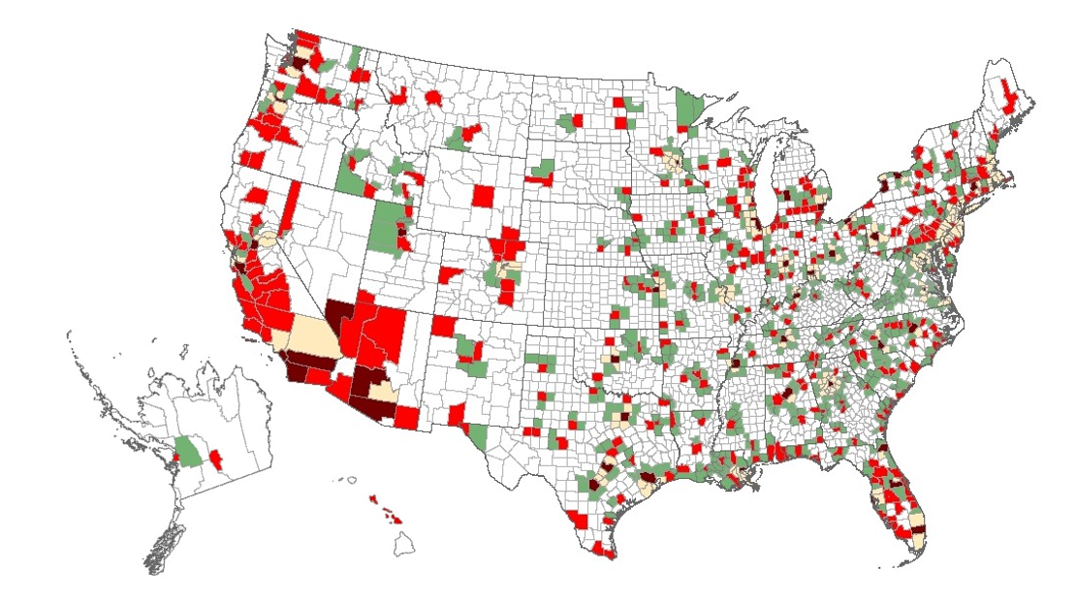
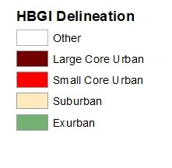
Homeownership Rate Across U.S. Counties
Average Homeownership Rate
Exurban counties: 75%
Large metro suburban counties: 72%
Smaller metro core counties: 65%
Large metro core counties: 54%

Slide 11
S&P CoreLogic Case-Shiller National US Home Price Index
Home prices dropped 6%, expected to grow at a relatively slow pace in the coming year
Source: NAHB forecast and S&P Dow Jones Indices LLC; CoreLogic, Inc..

Slide 12
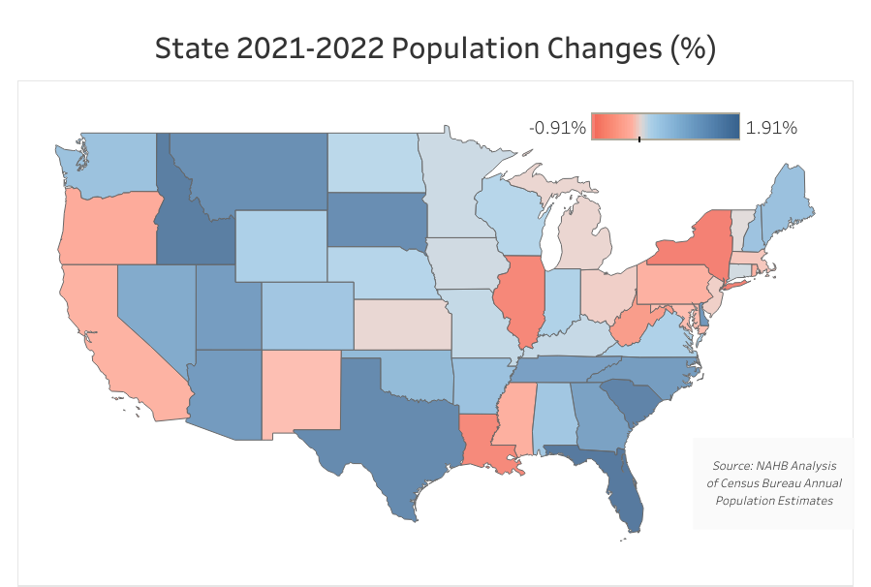
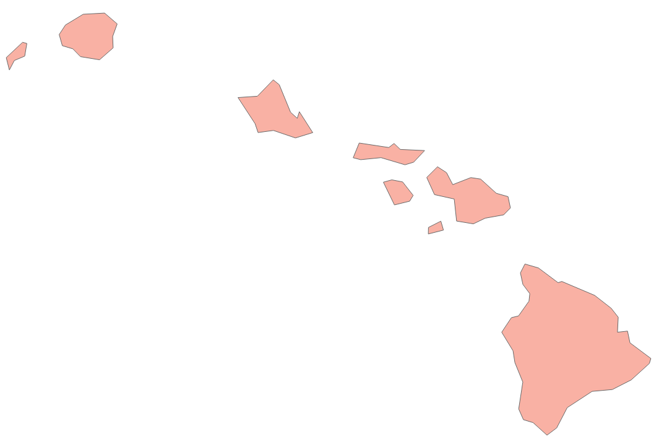
2021-2022 Population Changes
Idaho, Florida and Texas lead population gains
Population growth strongest in West and South
Smaller metro areas growing faster than larger
Some of the 2020 trends slowed in 2021

Slide 13
Total Housing Inventory
Insufficient resale inventory is supporting demand for new construction
Source: U.S. Census Bureau (BOC) and National Association of Realtors (NAR)

Slide 14
Housing Affordability Declines? NAHB/Wells Fargo HOI Lower
U.S.
Source: NAHB/Wells Fargo Housing Opportunity Index (HOI).

Slide 15
Supply-Side Factors

Slide 16
Labor – Construction Job Openings Peaked for Cycle?
Skilled labor shortage persists; 331,400 net gain for residential construction since Jan 2020
Source: U.S. Bureau of Labor Statistics (BLS).

Slide 17
Lumber Prices Edged Down
Current September price is $431; down 0.2% for the first time in four weeks
$ per thousand board feet
Source: NAHB Analysis; Random Lengths Composite Index

Slide 18
Building Materials Prices - Gypsum
Gypsum YOY growth rate have slowed from 20% to 3% over the past ten months
Index Dec 1993=100, NSA
YOY Growth Rate (Bars)
Source: NAHB Analysis; U.S. Bureau of Labor Statistics (BLS)

Slide 19
Lending – AD&C Loan Conditions
Credit for builders tightens as rates climb
Fed SLOOS
The average effective rate continued to climb in 2023Q2:
from 12.59% to 12.85% on speculative single-family construction loans
from 12.01% to 12.67% on pre-sold single-family construction loans
Source: NAHB survey; Federal Reserve’s Senior Loan Officer Opinion Survey (SLOOS)

Slide 20
Lot Shortages Reported by Single-family Builders
Shortage of lots reached a new record in 2021
Source: Census Bureau and NAHB/Wells Fargo HMI survey

Slide 21
Regulatory Costs $93,870 Per New Home (11% Gain 2016 to 2021)
Total effect of building codes, land use, environmental and other rules
23.8% of price
Source: NAHB/Wells Fargo Housing Market Index (HMI)

Slide 22
Building Systems Data

Slide 23
Modular/Panelized Production
Modular/Panelized Share
2% in 2022
7% in 1998
Source: NAHB tabulation of data from the Survey of Construction, U.S. Census Bureau.

Slide 24
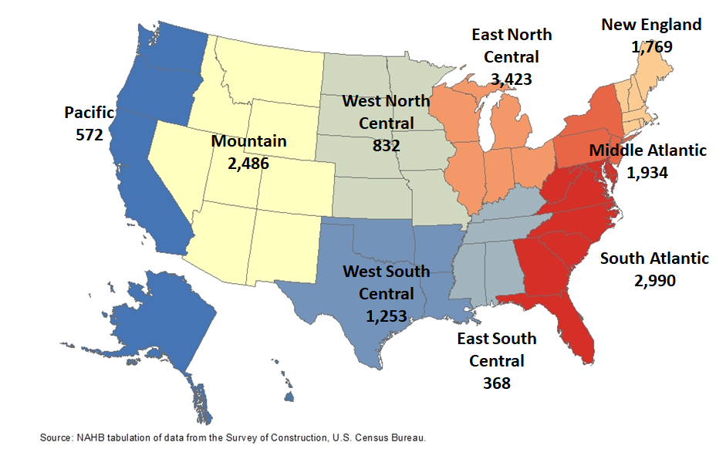
Modular Homes Started in 2022
U.S. Total: 15,627
More than 70% East of the Mississippi

Slide 25
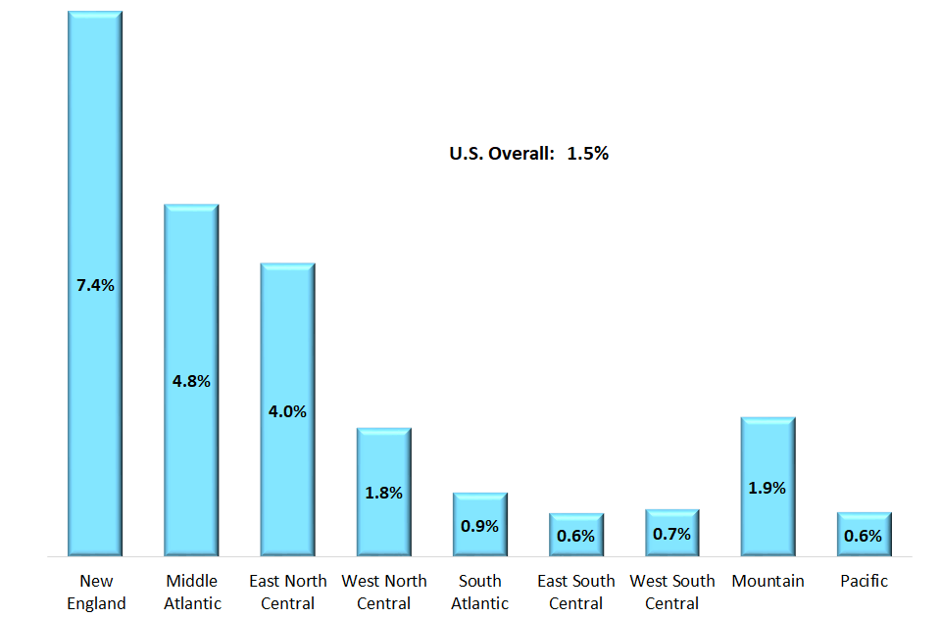
Market Penetration of Modular Construction by Division
Modular Share of All Single-family Homes Started in 2022
Source: NAHB tabulation of data from the Survey of Construction, U.S. Census Bureau.

Slide 26
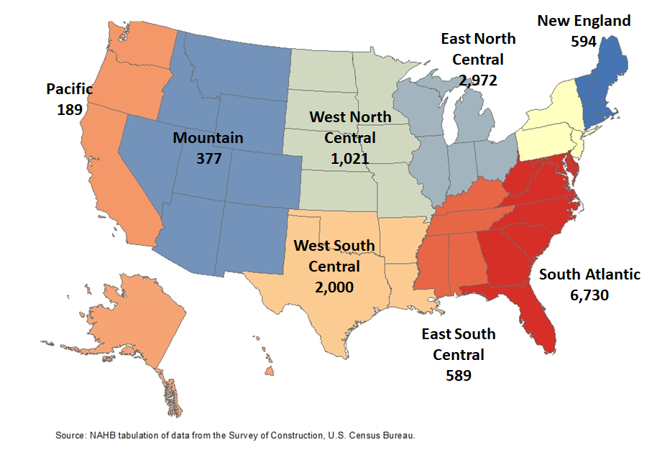
Panelized/Precut Homes Started in 2022
U.S. Total: 14,843
45% in South Atlantic

Slide 27
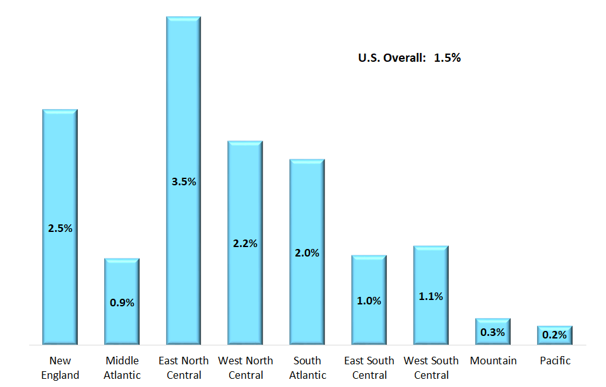
Market Penetration of Panelized Construction by Division
Panelized/Precut Share of All Single-family Homes Started in 2022
Source: NAHB tabulation of data from the Survey of Construction, U.S. Census Bureau.

Slide 28
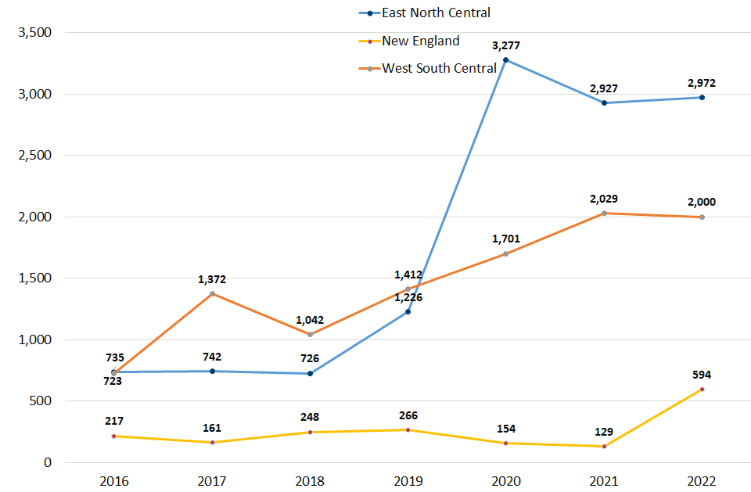
Number of Panelized Single-Family Starts
Panelized/Precut Share has substantially increased in three division since 2016
Source: NAHB tabulation of data from the Survey of Construction, U.S. Census Bureau.

Slide 29
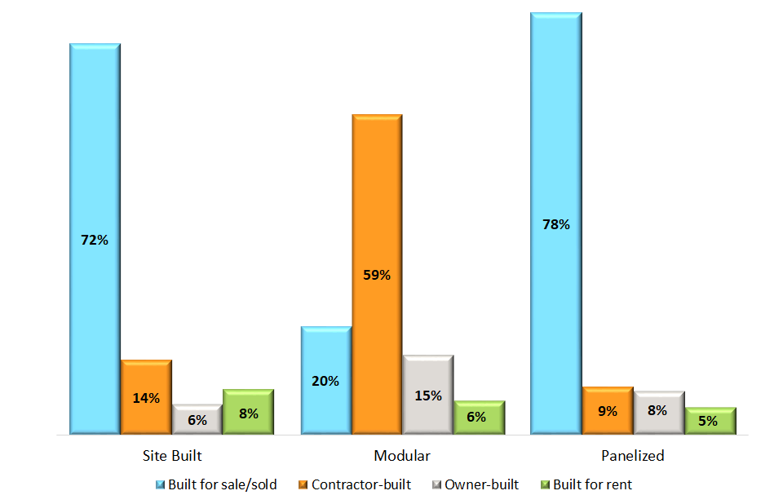
Purpose of Construction
Majority of modular homes started in 2022 were custom homes
Source: NAHB tabulation of data from the Survey of Construction, U.S. Census Bureau.

Slide 30
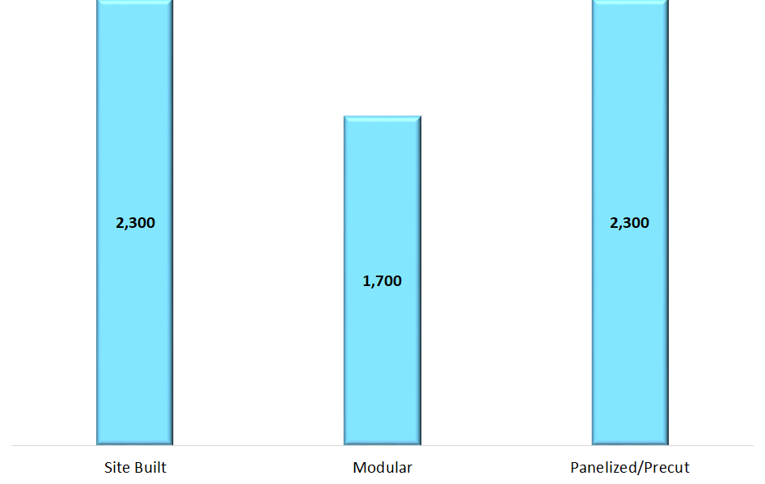
Size of New Homes Started in 2022
Median Square Footage of Finished Floor Space
Source: NAHB tabulation of data from the Survey of Construction, U.S. Census Bureau.

Slide 31
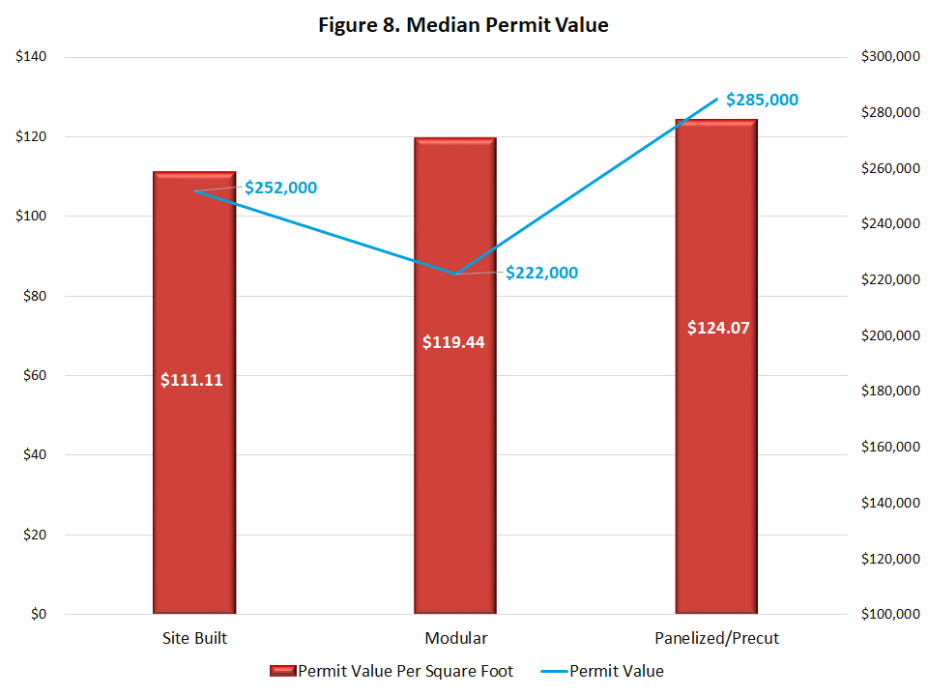
Permit Value of New Homes Started in 2022
Source: NAHB tabulation of data from the Survey of Construction, U.S. Census Bureau.

Slide 32
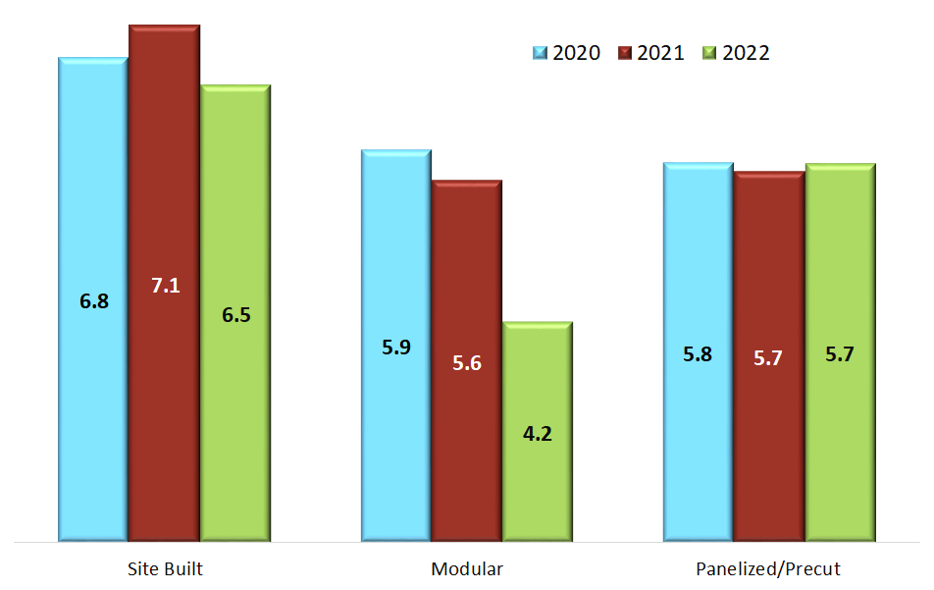
Census Data on Construction Time
Average Time from Start to Completion for Single-family Homes Completed in 2022
Source: NAHB tabulation of data from the Survey of Construction, U.S. Census Bureau.

Slide 33
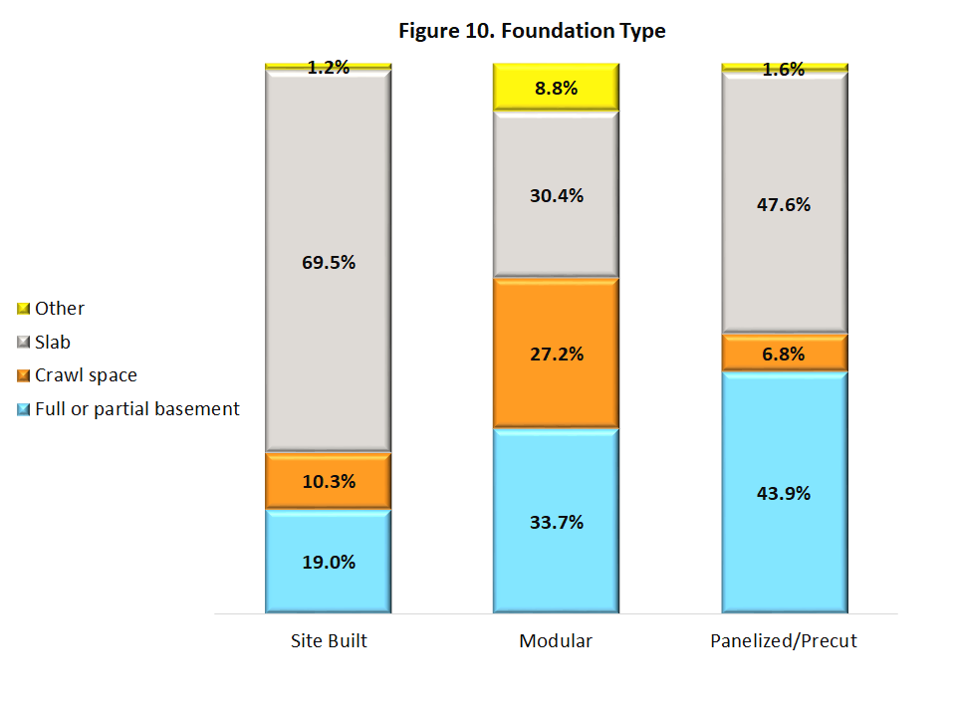
Foundation Type
Single-family Homes Started in 2022
Source: NAHB tabulation of data from the Survey of Construction, U.S. Census Bureau.

Slide 34
Manufactured Home Shipments
Forecast calls for limited declines due to affordability concerns
Year | Units | % Change
2020 | 94,000 | -1%
2021 | 106,000 | 13%
2022 | 112,000 | 6%
2023^{f} | 87,000 | -23%
2024^{f} | 102,000 | 17%
2025^{f} | 115,000 | 13%
Source: U.S. Census Bureau (BOC) and NAHB forecast

Slide 35
Construction
Outlook

Slide 36
NAHB/Wells Fargo Housing Market Index (HMI)
Builder confidence fell on rising mortgage rates
Source: Census Bureau and NAHB/Wells Fargo HMI survey

Slide 37
Single-Family Starts
Construction to trend higher in the quarters ahead
Year | Units | % Change
2020 | 1,003,000 | 13%
2021 | 1,132,000 | 13%
2022 | 1,004,000 | -11%
2023^{f} | 905,000 | -10%
2024^{f} | 946,000 | 5%
2025^{f} | 1,027,000 | 8%
Source: U.S. Census Bureau (BOC) and NAHB forecast

Slide 38
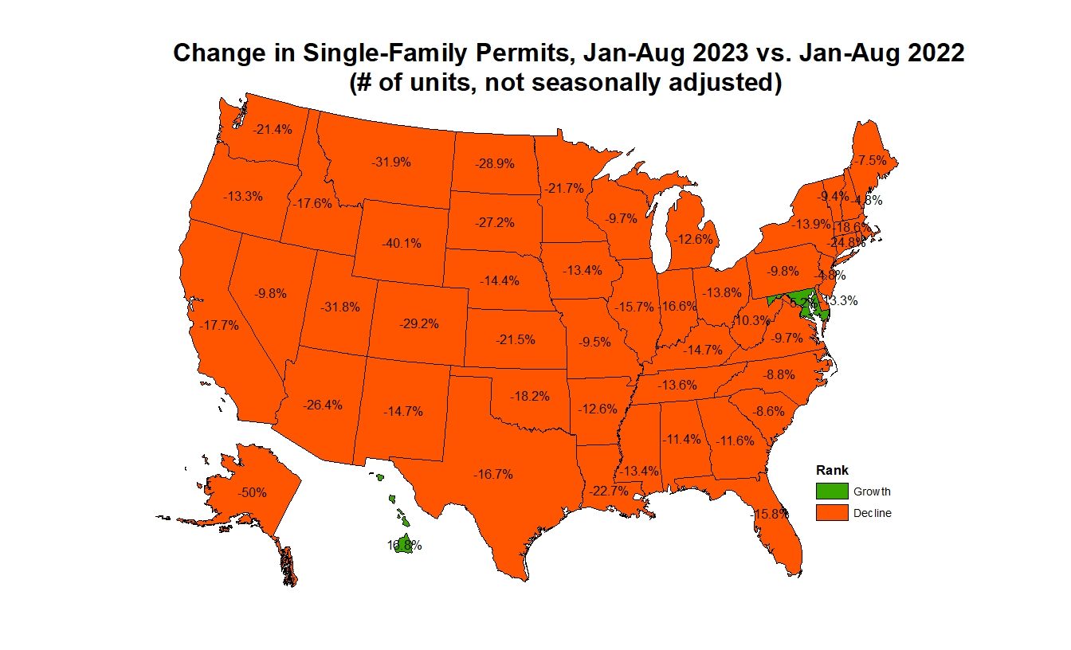
Growth in Single-Family Permits
Source: U.S. Census Bureau (BOC).

Slide 39
Top 10 Largest Single-Family Markets by Permits
Top 10 Largest SF Markets | July 2023 (# of units YTD, NSA) | YTD % Change (compared to July 2022)
Houston-The Woodlands-Sugar Land, TX | 29,687 | -8%
Dallas-Fort Worth-Arlington, TX | 24,088 | -19%
Atlanta-Sandy Springs-Roswell, GA | 14,417 | -14%
Phoenix-Mesa-Scottsdale, AZ | 13,302 | -33%
Charlotte-Concord-Gastonia, NC-SC | 11,174 | -13%
Orlando-Kissimmee-Sanford, FL | 10,020 | -9%
Austin-Round Rock, TX | 9,202 | -39%
Nashville-Davidson--Murfreesboro--Franklin, TN | 8,669 | -17%
Tampa-St. Petersburg-Clearwater, FL | 8,050 | -22%
Raleigh, NC | 7,639 | -10%
Source: U.S. Census Bureau (BOC).

Slide 40
Medium-Term Outlook for Residential Construction
2024
Fed will ease, interest rates will normalize
Single-family home building will lead a recovery
Demand will return, but supply-side issues will increase
Lack of lots
AD&C availability
Building material constraints
2025 through 2030
Demographics yield a good runway for home building growth
Structural housing deficit will be reduced
Single-family home building volumes near or above 1.1 million per year
2030 and after
Declining demographics weaken multifamily and single-family demand

Slide 41
Thank you
Questions?
dnanayakkara@nahb.org
eyeonhousing.org housingeconomics.com

